Slide 1


Music genre prediction
Yasmin Hammad
Yousef Al Farani
Mahmoud Abdelqader
Malak Kanana

Slide 2

1-Define the problem
2-EDA
preprocessing
5-Modling
6-Evaluation

Slide 3
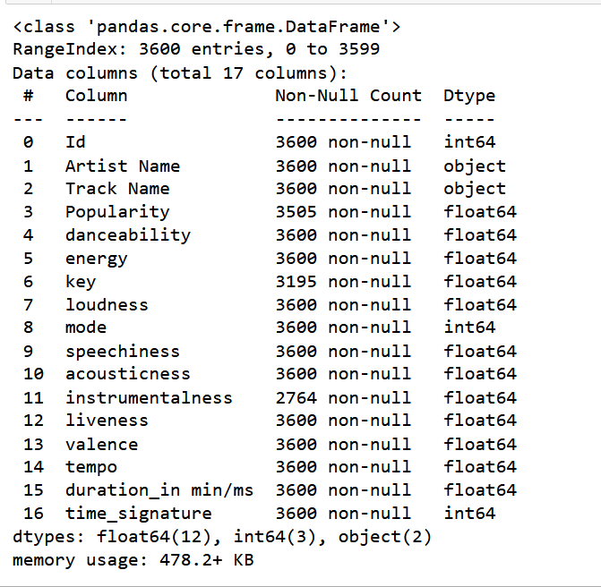


About dataset
Project goal to create a Machine learning model for music genre classification
train dataset consist of 14,396 rows

Slide 4
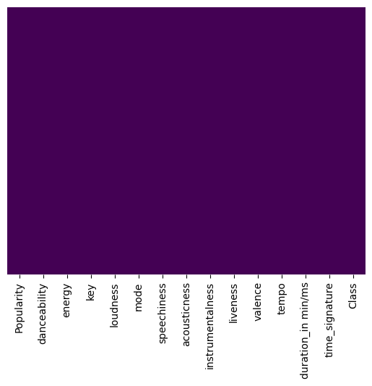
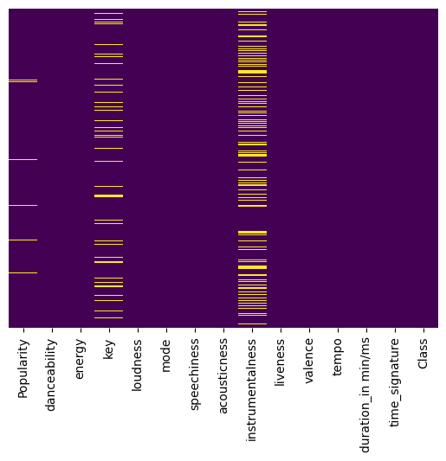
Data Preprocessing
Handling missing value
train["Popularity"].fillna(train["Popularity"].mean(),
inplace=True)
train["key"].fillna(train["key"].mode()[0], inplace=True)
train["instrumentalness"].fillna(0, inplace=True

Slide 5
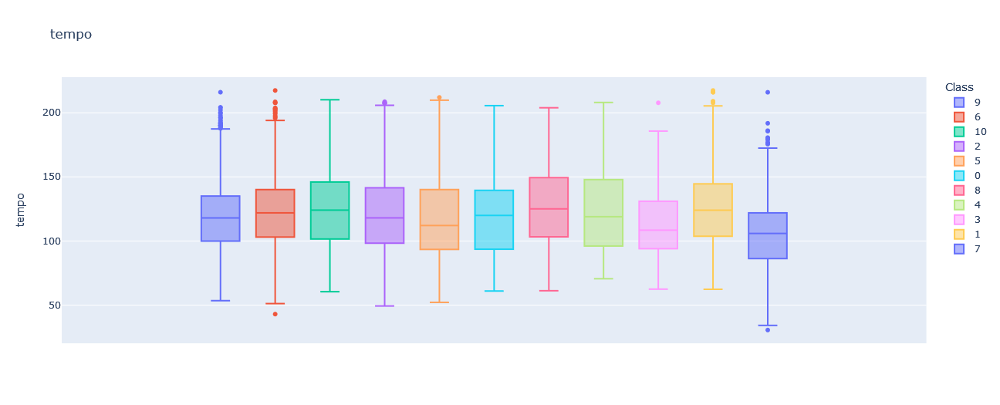
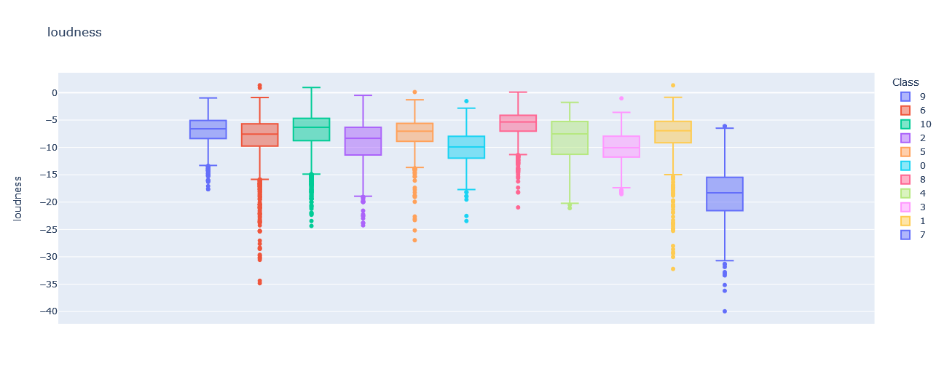
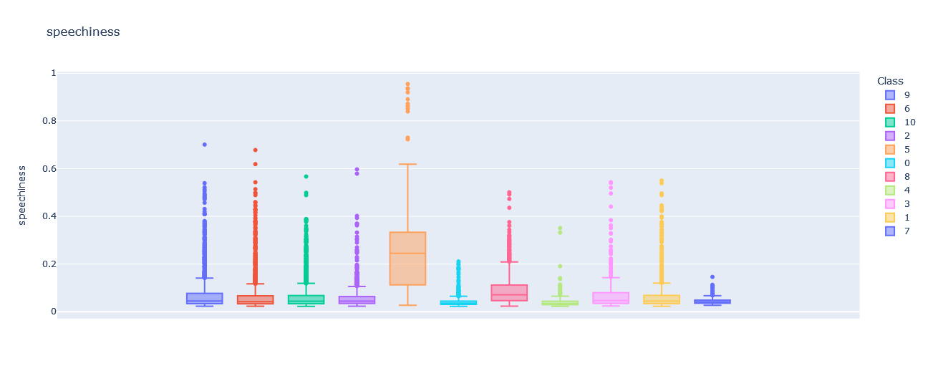
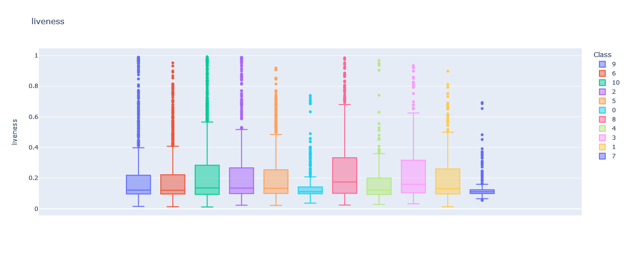
Remove duplicate data
Dealing with outliers

Slide 6
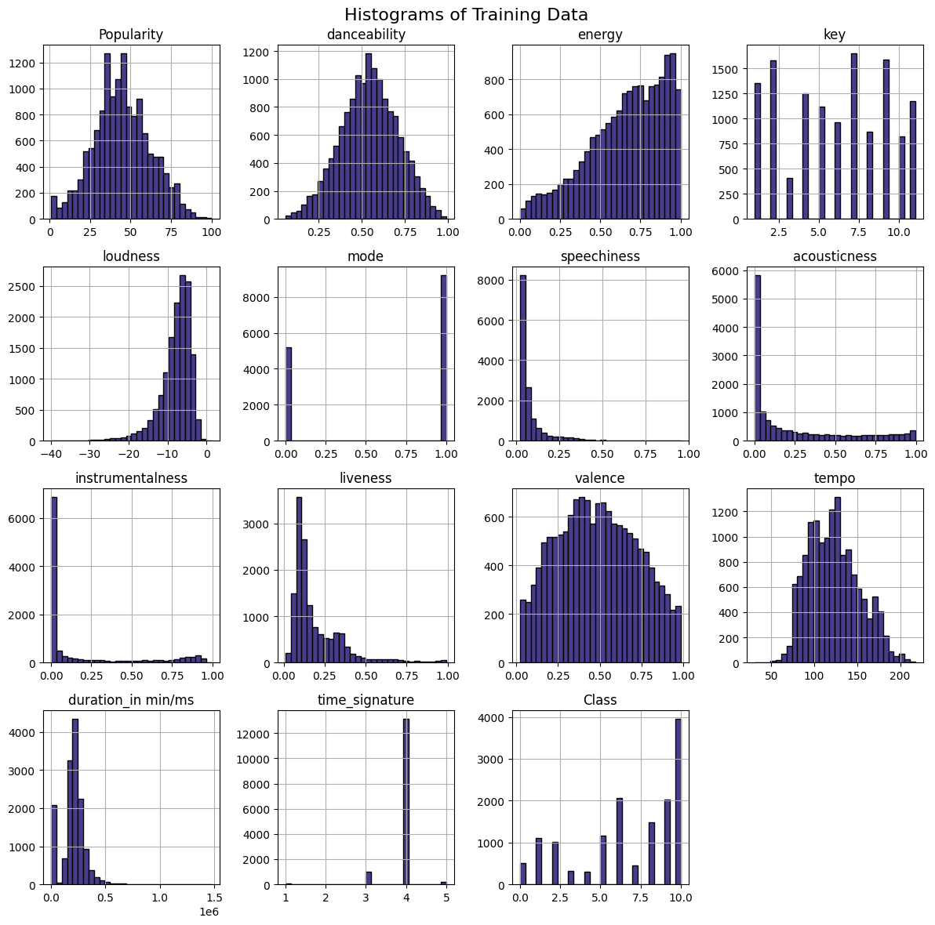
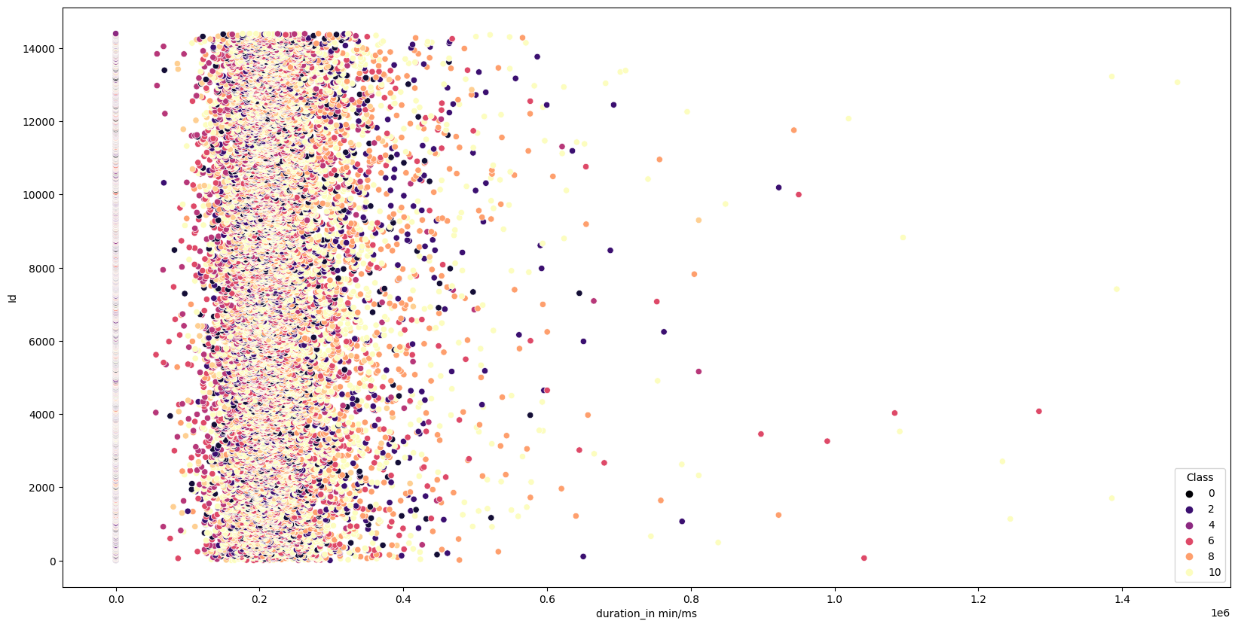
EDA
EDA

Slide 7
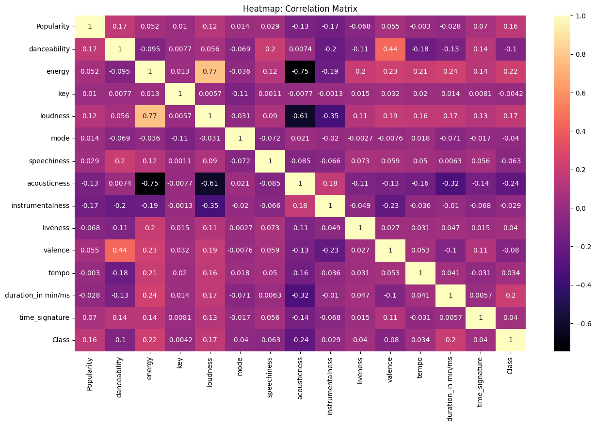
Correlation

Slide 8
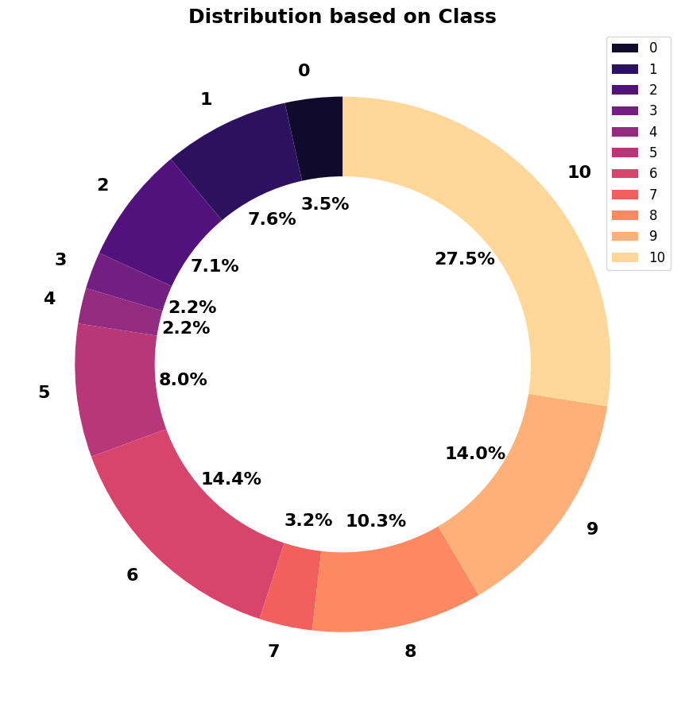
Class distribution

Slide 9


Standard Scaler for x
Normalize the data

Slide 10

Modeling
Classification Models Used: RandomForest, GradientBoosting, and CatBoostm, ExtraTreesClassifier, LGBMClassifier
Evaluation Metric: Accuracy

Slide 11

Mention the ensemble approach used: StackingClassifier Highlight the achieved accuracy: 57%
The achived accuracy using catboost alone with categorical data equal:70%

Slide 12
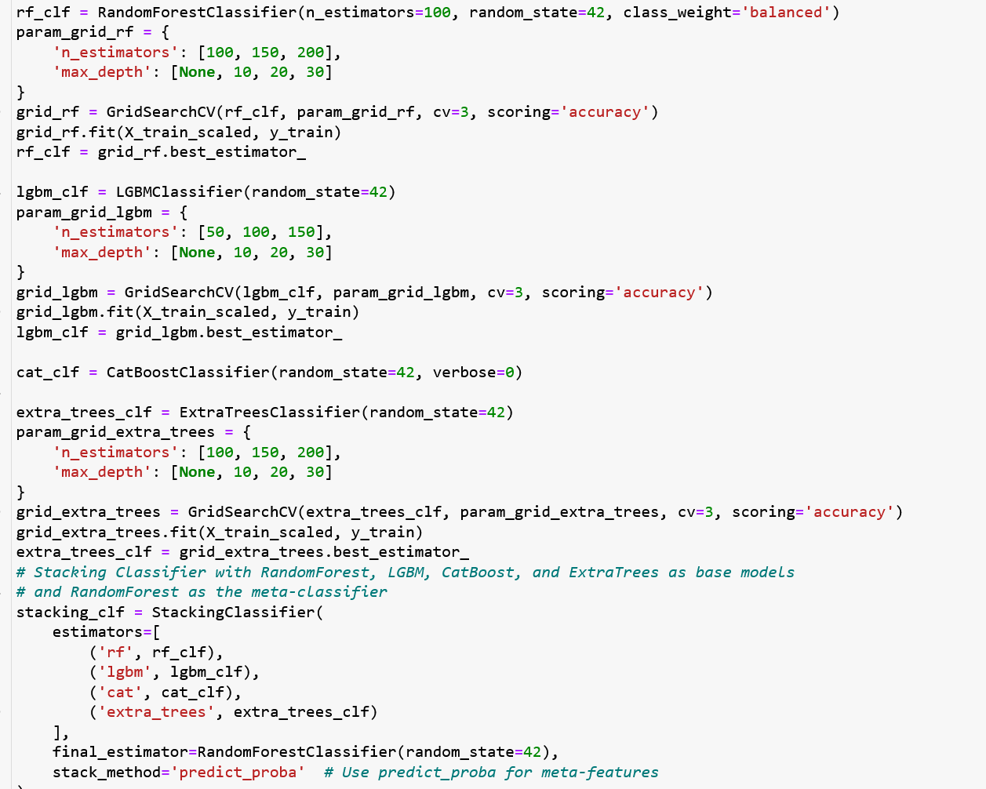
Hyperparameter
Present the best hyperparameter values obtained through gridSearchCV.
Explain how these hyperparameters contributed to the improved accuracy.

Slide 13
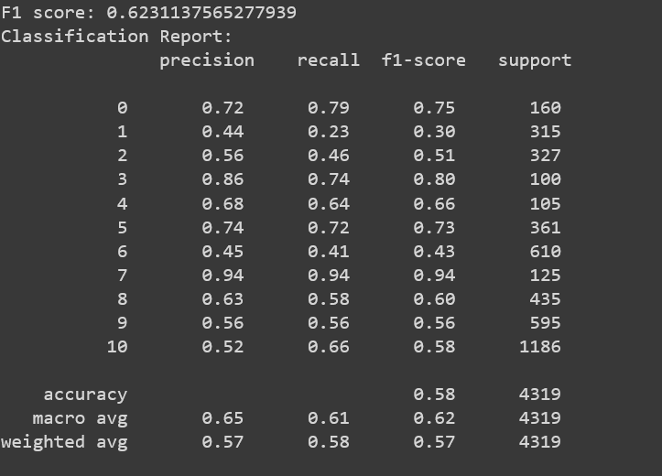
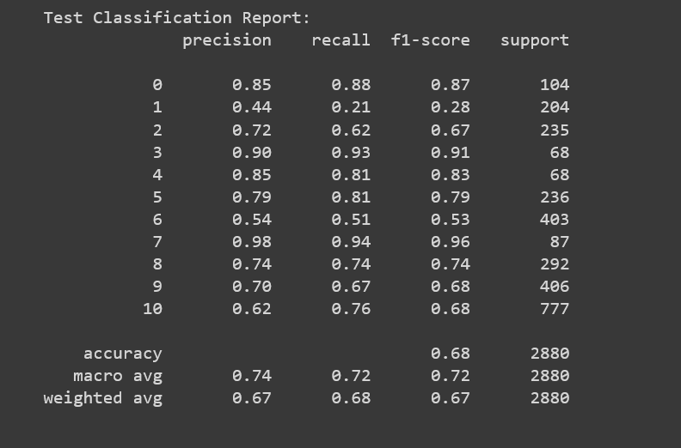
Results:
Highest accuracy with stacking
Highest accuracy of Catboost alone

Slide 14

The End

